Slide 1
“Prediction of building energy consumption”
Artificial neural network model for forecasting sub-hourly electricity usage in Commercial buildings. Energy Build2016;111:184–94.
A hybrid model approach for forecasting future residential electricity consumption. Energy Build 2016;117:341–51.
Energy AI Track Kim Sohee
Notes:
A review on the prediction of building energy consumption
https://doi.org/10.1016/j.rser.2012.02.049
Zhao, Hai-xiang, and Frédéric Magoulès. "A review on the prediction of building energy consumption."
Renewable and Sustainable Energy Reviews 16.6 (2012): 3586-3592.
A review of data-driven building energy consumption prediction studies
https://doi.org/10.1016/j.rser.2017.04.095

Slide 2

Contents
Prediction models for forecasting building energy consumption
Artificial neural network model for forecasting sub-hourly electricity usage in Commercial buildings
A hybrid model approach for forecasting future residential electricity consumption

Slide 3
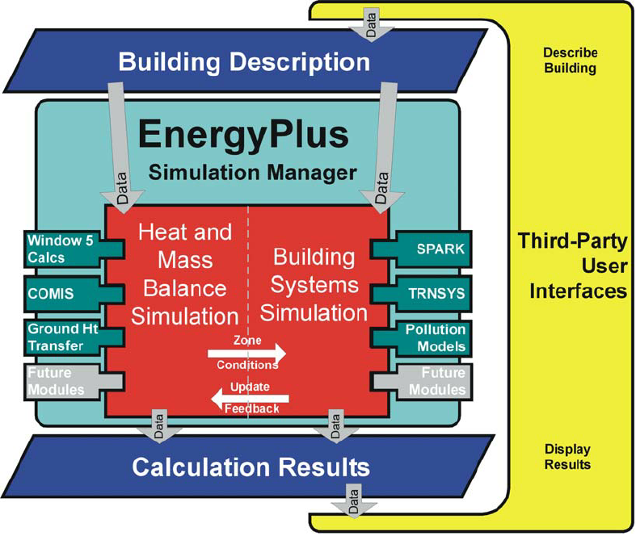
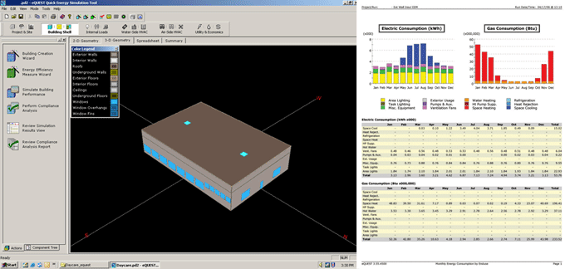
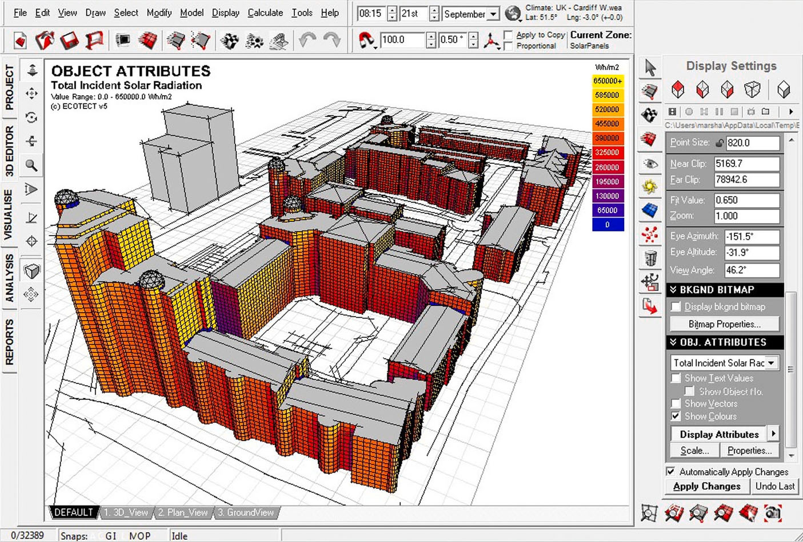
1. Prediction models for forecasting building energy consumption
2. Artificial neural network model for forecasting sub-hourly electricity usage in Commercial buildings
3. A hybrid model approach for forecasting future residential electricity consumption
Prediction models
Engineering models (Physical models)
Rely on thermodynamic rules for detailed energy modelling and analysis
Software : EnergyPlus, eQuest, and Ecotect
Calculate building energy consumption based on detailed building and environmental parameters
Detailed data may not be available to the users at the time of simulation
Failure to provide accurate input can result in poor prediction performance
> EnergyPlus
(whole building energy simulation program)
> eQuest
(Building energy analysis program)
> EcoTect
Notes:
There are several popular methods used for forecasting building energy consumption, that can be categorized into two main approaches, engineering and data-driven approach.
First, Engineering models rely on thermodynamic rules for detailed energy modelling and analysis.
Examples of building energy simulation software that utilize physical models include EnergyPlus, eQuest, and Ecotect.
These types of software calculate building energy consumption based on detailed building and environmental parameters such as building construction details; operation schedules; HVAC design information; and climate, sky, and solar/shading information.
The pictures shows each software program.
EneryPlus is a whole building energy simulation program, and eQuest is a building energy analysis program.
Ecotect is a program that supports architect's design through analysis of various factors of building performance for energy efficiency and sustainable design.
However, some of such detailed data may not be available to the users at the time of simulation.
Failure to provide accurate input can result in poor prediction performance.

Slide 4
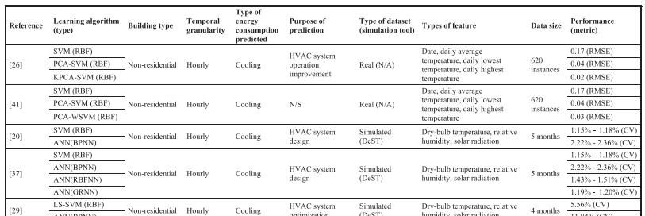
1. Prediction models for forecasting building energy consumption
2. Artificial neural network model for forecasting sub-hourly electricity usage in Commercial buildings
3. A hybrid model approach for forecasting future residential electricity consumption
Prediction models
Data-driven models
Learns from historical/available data for prediction
Correlate the energy consumption or energy index with the influencing variables
4 steps : data collection, data preprocessing, model training, and model testing
Machine learning algorithms : SVM, ANN, decision trees, and other statistical algorithms
Notes:
Data-driven modelling does not perform such energy analysis or require such detailed data about the simulated building, and instead learns from historical/available data for prediction. They correlate the energy consumption or energy index with the influencing variables.
Data-driven prediction has gained a lot of research attention in recent years, despite its possible limitations.
Developing a data-driven model, typically, consists of four primary steps: data collection, data preprocessing, model training, and model testing.
SVM, ANN, decision trees, and other statistical algorithms are the most commonly-used supervised machine learning algorithms for model training.
This table summarizes the features used in the reviewed models.

Slide 5
1. Prediction models for forecasting building energy consumption
2. Artificial neural network model for forecasting sub-hourly electricity usage in Commercial buildings
3. A hybrid model approach for forecasting future residential electricity consumption
Prediction models
Data-driven models Limitations
Data-driven prediction models may not perform well outside of their training range.
Black-box models – their internals are not known
Hybrid or grey-box modelling approaches (physical + data-driven)
Black-box model
Artificial neural network model for forecasting sub-hourly electricity usage in Commercial buildings.
Chae YT, Horesh R, Hwang Y, Lee YM. Energy Build 2016;111:184–94.
Data-driven models
Prediction
models
Physical models
Grey-box model (hybrid)
A hybrid model approach for forecasting future residential electricity consumption.
Dong B, Li Z, Rahman SMM, Vega R. Energy Build 2016;117:341–51.
Notes:
Despite the importance of data-driven approaches, It has two main limitations.
First, Data-driven prediction models may not perform well outside of their training range.
And they are black-box models, their internals are not known.
On the other hand, Hybrid or grey-box modelling approaches offer a combination of physical and data-driven prediction models, thereby leveraging the advantages and minimizing the disadvantages of both approaches.
There are several papers which developed a hybrid model.
Tae Chae et al. utilized ANN to forecast sub-hourly electricity usage in a commercial building complex [47]. It was seen that the ANN with15-min interval data forecasted accurately with more training data. The Mean Bias Error by taking 1, 2, 3 and 4 weeks for training are −10.4,−5.6, −2.3 and 0.03 respectively.
Chae et al. [48] developed forecasting models using ANN for sub-hourly electricity usage for a commercial building complex. The input variables that were selected for model development were the day type, time of day, HVAC set-point temperature schedules, outdoor air dry-bulb temperature and humidity. The results show that the daily peak prediction with past four weeks’ training data performs the best. Three training methods that were used were Static, accumulative and sliding window with average APE of 3% and 4.5% for weekdays of August and September

Slide 6
2. Artificial neural network model for forecasting sub-hourly electricity usage in Commercial buildings.
1. Prediction models
2. Artificial neural network model for forecasting sub-hourly electricity usage in Commercial buildings
3. A hybrid model approach for forecasting future residential electricity consumption
Chae YT, Horesh R, Hwang Y, Lee YM.
Energy Build 2016;111:184–94.

Slide 7
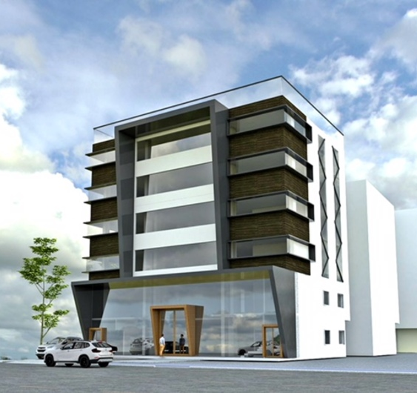
1. Prediction models
2. Artificial neural network model for forecasting sub-hourly electricity usage in Commercial buildings
3. A hybrid model approach for forecasting future residential electricity consumption
Introduction
Forecasting electricity load – commercial & industrial buildings
To be able to better manage energy usage
The short-term load forecast (STLF) – a period shorter than a day → more interest
∵ The utility prices may change by seasonality, time-of-use in on/off peak period, and contract demand
Notes:
Forecasting electricity load, especially for commercial and industrial buildings has become one of the more important topics recently, to be able to better manage energy usage.
Although the forecast time horizon can range from minutes to years, the short-term load forecast (STLF), especially for a period shorter than a day, has been more of an interest in the perspective of buildings / because the utility prices may change by seasonality, time-of-use in on/off peak period, and contract demand.

Slide 8


2. Artificial neural network model for forecasting sub-hourly electricity usage in Commercial buildings
1. Prediction models
3. A hybrid model approach for forecasting future residential electricity consumption
Introduction
The short-term load forecast (STLF) – sub-hourly electricity consumption of buildings
Escriva-Escriva et al. – STLF model using ANNs
Requires an entire whole year’s data set
Not be stable when the energy consumption pattern has large daily or annual variability
A short-term load forecasting model using data mining and machine learning technique while assuming limited availability of data.
ANN models – commercial building complex
Notes:
Previous studies on STLF for the sub-hourly electricity consumption of buildings are limited.
Escriva-Escriva et al. [14] proposed STLF model using ANNs,
but this model requires an entire whole year’s dataset / and the performance may not be stable when the energy consumption pattern has large daily or annual variability.
Therefore, it is useful to explore a model that can perform well under more general setting, in particular, not requiring a large amount of input data for forecasting electricity usage of buildings.
For this need, they developed a short-term load forecasting model using data mining and machine learning technique while assuming limited availability of data.
In particular, they investigate ANNs model to predict the energy consumption of a commercial building complex.

Slide 9
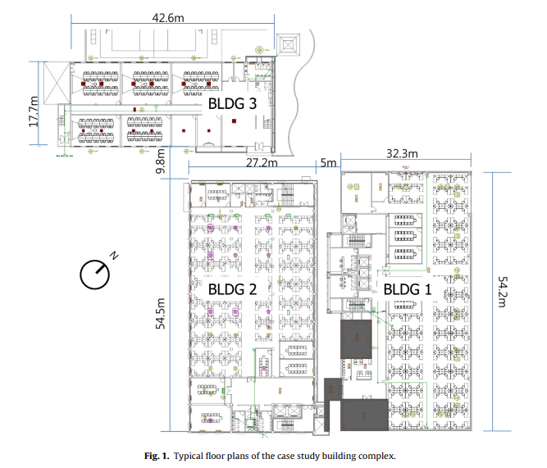
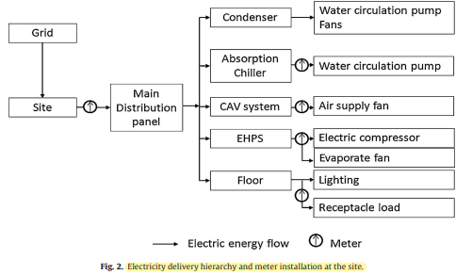
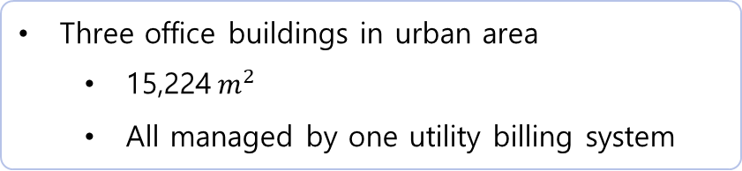
1. Prediction models
2. Artificial neural network model for forecasting sub-hourly electricity usage in Commercial buildings
3. A hybrid model approach for forecasting future residential electricity consumption
Methodological approach
Description of a case study: a building complex
Three office buildings in urban area
15,224$m^{2}$
All managed by one utility billing system
2 floor
4 floor
5 floor
Notes:
The site consists of three office buildings in urban area, each of which has different number of floors.

Slide 10
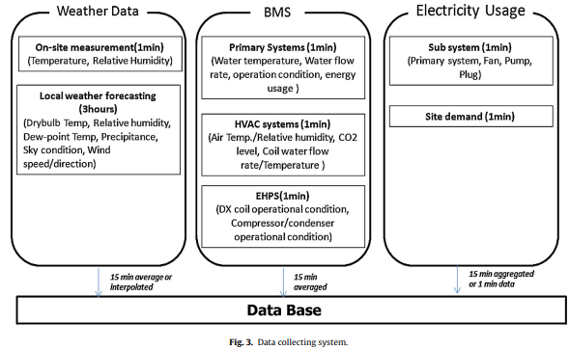
1. Prediction models
2. Artificial neural network model for forecasting sub-hourly electricity usage in Commercial buildings
3. A hybrid model approach for forecasting future residential electricity consumption
Methodological approach
Data collection and processing
Notes:
The relational database management system (RDBMS) has been used to collect and store environmental variables, BMS data, and electricity usage as illustrated here.
Dataset has over 1000 data points with 20 different measurement types. / some variables are not used for forecast.
So the predictors are divided into 3 categories ->

Slide 11
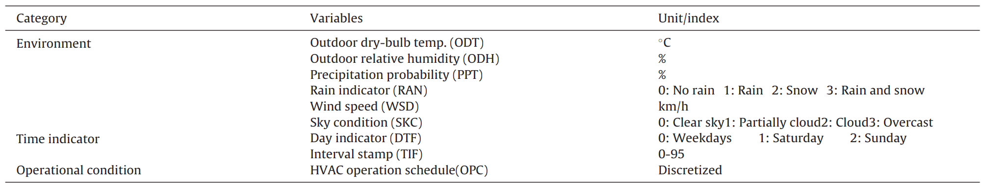
1. Prediction models
2. Artificial neural network model for forecasting sub-hourly electricity usage in Commercial buildings
3. A hybrid model approach for forecasting future residential electricity consumption
Methodological approach
Data collection and processing
> Potential predictor variables
Environmental data
ODT, ODH, PPT, RAN, WSD, SKC
Time indicator
DTF, TIF
Operational condition
OPC
9 potential variables
Notes:
Environmental data, time indicator, and operational condition.
The data include outdoor air temperature, relative humidity, wind speed and direction, sky condition, and precipitation(강수량) type in every 3-hour interval for the next 72 hours. The forecast data is updated eight times a day.
And RDBMS converts string variables into numeric variables as shown.
An averaged system operation schedule of five CAV systems was used as the HVAC operational condition.
However, In nine independent variables, some variables can decrease model accuracy, stability, and effectiveness. Therefore, it is necessary to pre-screen the variables by identifying the important variables from the input data set.

Slide 12
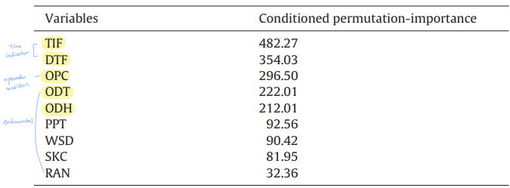
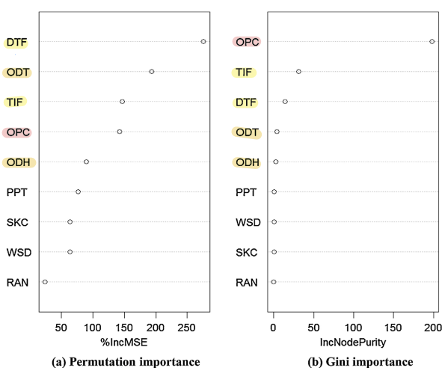
1. Prediction models
2. Artificial neural network model for forecasting sub-hourly electricity usage in Commercial buildings
3. A hybrid model approach for forecasting future residential electricity consumption
Methodological approach
Feature extraction for dimension reduction
5 variables
Random forests algorithm
+ Previous electricity usages
Notes:
So Random forests algorithm was used to assess the importance of variables by measuring the candidate parameters in terms of their impacts on the response of prediction.
The permutation importance and Node impurity were used to select variables in this study
The permutation importance estimates the importance of each predictor by considering prediction error variation when the variable is permuted but others are kept the same. Node impurity is measured by the total decrease in residual sum of squares from splitting on the variable, averaged over all trees.
Variables are ranked by both relative importance metrics in left figure.
According to this, Outdoor air temperature, relative humidity and operational condition has more importance.
It has a similarity to the conditional permutation importance at right Table.
So, these 5 variables are ranked highly in their importance.
These and previous electricity usages are selected as input variables.

Slide 13
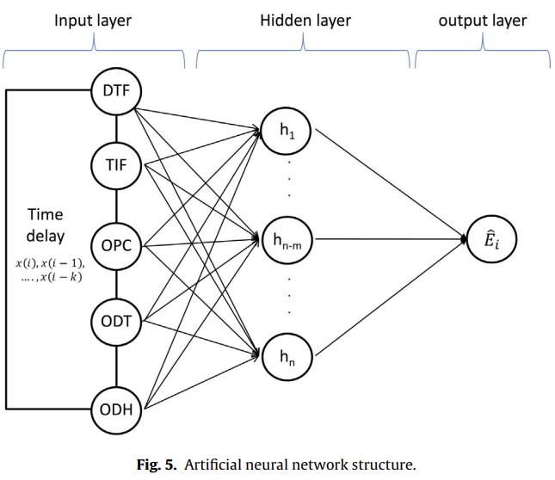
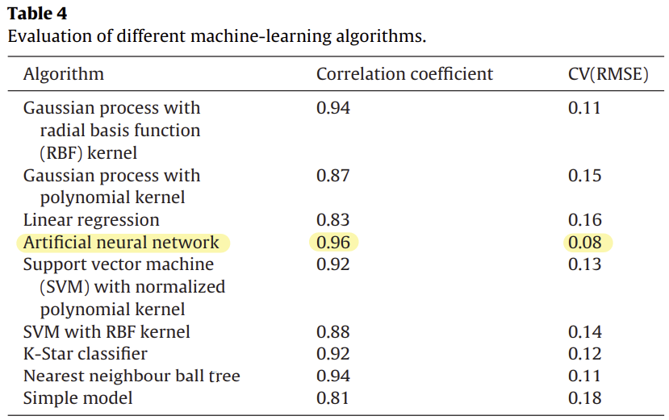
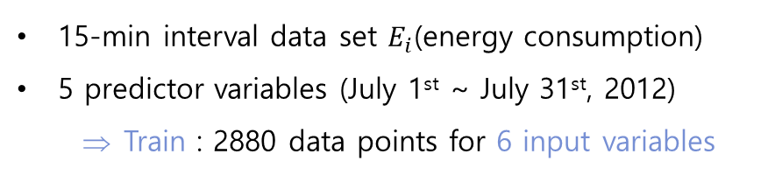
1. Prediction models
2. Artificial neural network model for forecasting sub-hourly electricity usage in Commercial buildings
3. A hybrid model approach for forecasting future residential electricity consumption
Methodological approach
Predictive model selection
ANN model architecture
15-min interval data set $E_{i}$(energy consumption)
5 predictor variables (July 1st ~ July 31st, 2012)
Train : 2880 data points for 6 input variables
> 9 machine-learning algorithms
Notes:
Next, In this study, they examined nine different machine-learning algorithms and chose the one that performed best, the ANN.
The 15 minute interval data set of Ei / and highly ranked 5 predictor variables were collected from July 1st to July 31st, 2012. Total of 2880 data points for 6 input variables including electric usage were used to train the model.

Slide 14
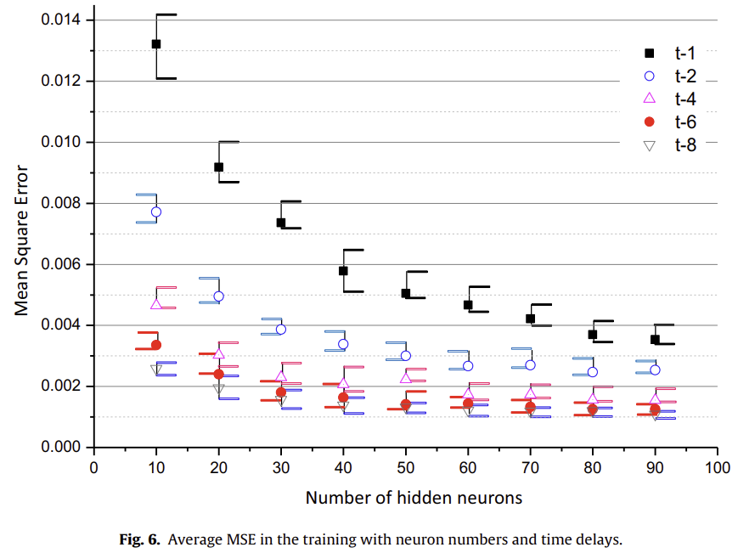
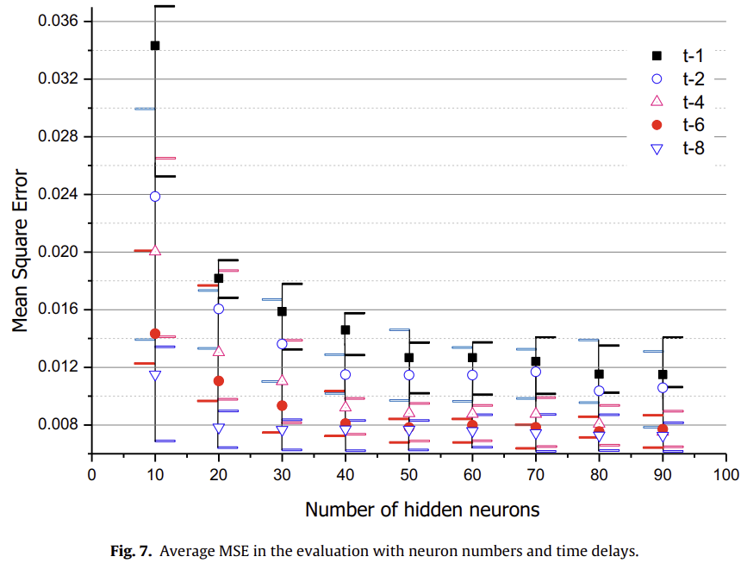
1. Prediction models
2. Artificial neural network model for forecasting sub-hourly electricity usage in Commercial buildings
3. A hybrid model approach for forecasting future residential electricity consumption
Results and discussion
Network design parameters - Hidden layer architecture and time-delayed inputs
Training
Evaluation

Slide 15
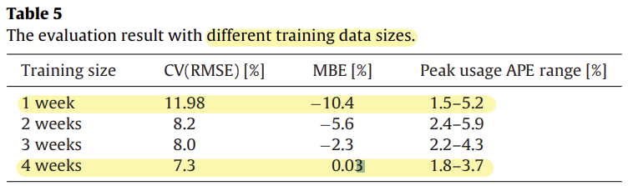
1. Prediction models
2. Artificial neural network model for forecasting sub-hourly electricity usage in Commercial buildings
3. A hybrid model approach for forecasting future residential electricity consumption
Results and discussion
Network design parameters - Training size for the prediction model

Slide 16
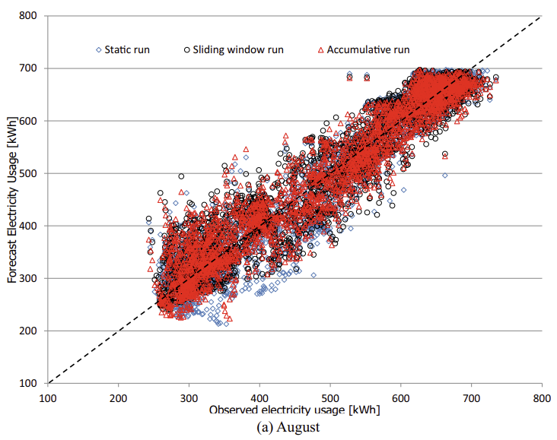
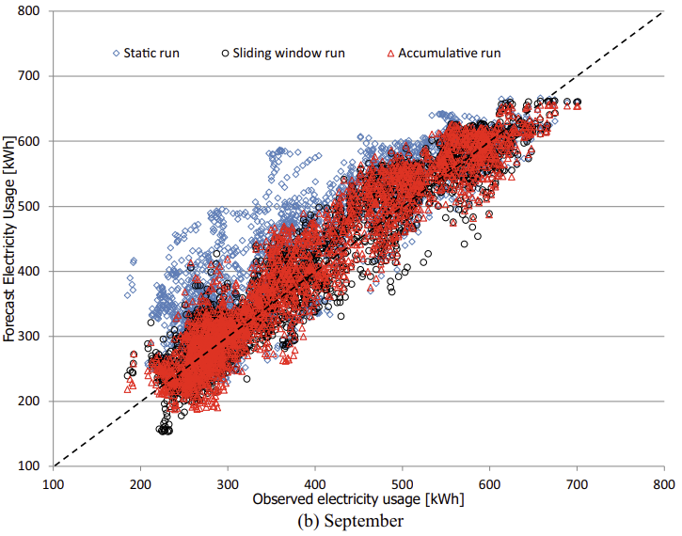
1. Prediction models
2. Artificial neural network model for forecasting sub-hourly electricity usage in Commercial buildings
3. A hybrid model approach for forecasting future residential electricity consumption
Results and discussion
Model implementation
> Comparisons of actual observed and forecasted electricity usage

Slide 17
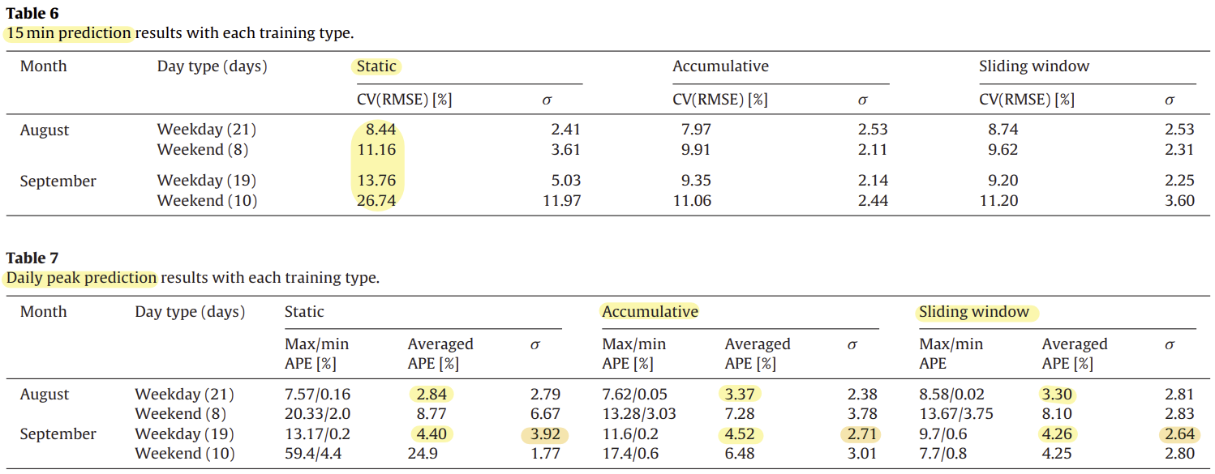
1. Prediction models
2. Artificial neural network model for forecasting sub-hourly electricity usage in Commercial buildings
3. A hybrid model approach for forecasting future residential electricity consumption
Results and discussion
Model implementation

Slide 18
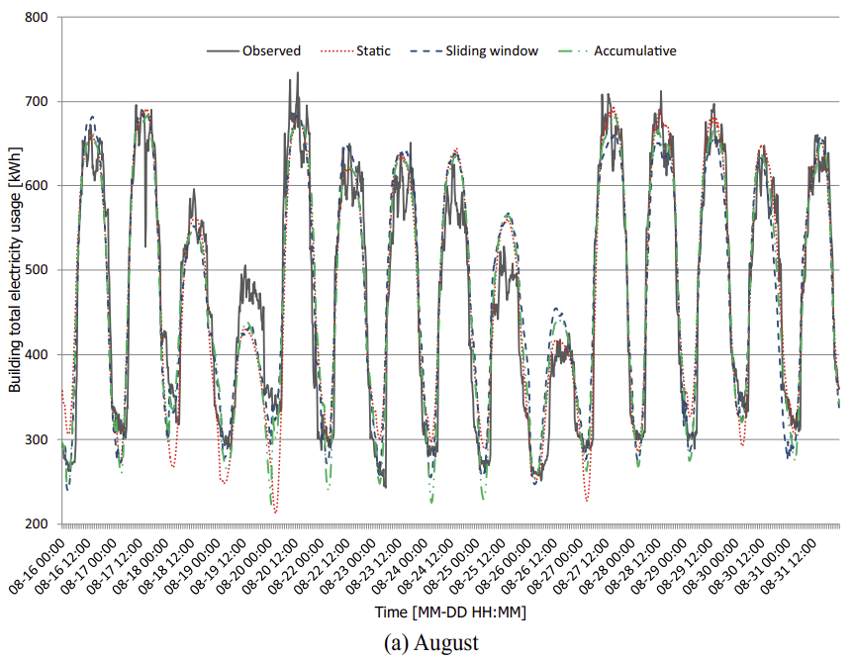
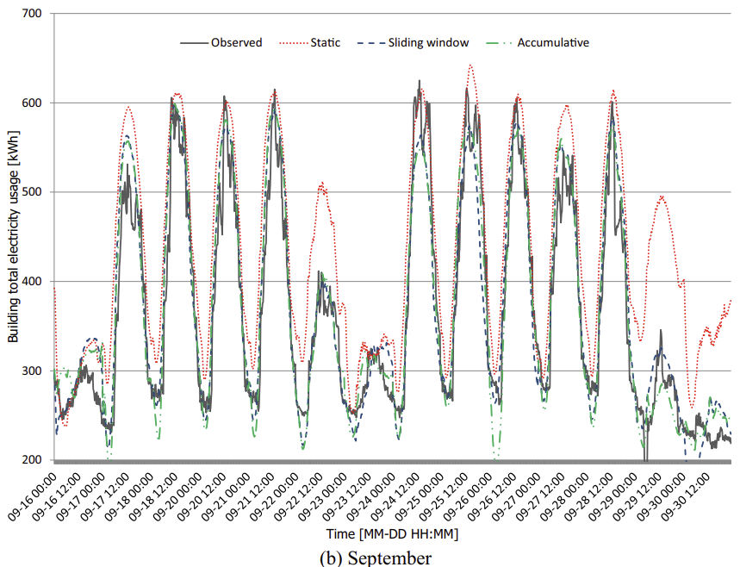
1. Prediction models
2. Artificial neural network model for forecasting sub-hourly electricity usage in Commercial buildings
3. A hybrid model approach for forecasting future residential electricity consumption
Results and discussion
Model implementation
> Actual forecast result

Slide 19
3. A hybrid model approach for forecasting future residential electricity consumption
1. Prediction models
2. Artificial neural network model for forecasting sub-hourly electricity usage in Commercial buildings
3. A hybrid model approach for forecasting future residential electricity consumption
Dong B, Li Z, Rahman SMM, Vega R. Energy Build 2016;117:341–51..

Slide 20

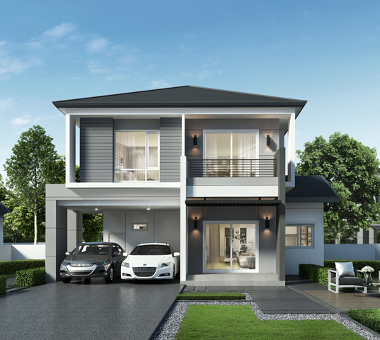
1. Prediction models
2. Artificial neural network model for forecasting sub-hourly electricity usage in Commercial buildings
3. A hybrid model approach for forecasting future residential electricity consumption
Introduction
Data-driven model - Black-box : machine learning driven, derived by measured data
Limited in one type of methods (neural networks)
Physical + Data-driven = Grey-box
Built upon physical relationship – parameters of physical model are unknown or uncertain.
+ Measured data → identify those parameters, model tuning for better accuracy
Commercial vs Residential building
The lack of hourly or more granular data
The growing percentage of miscellaneous electrical load (MEL) in residential building (~52%)
기타 전기부하 비율
A new hybrid modeling approach
Forecast hour ahead and 24 ahead residential electrical load
Notes:
“Data-Driven” models rely more on the data, assuming there is already a mathematical relationship between inputs (e.g. weather parameters) and outputs (e.g. total building energy consumptions).
To further categorize the “Data-Driven” approach, there are “black-box” and “grey-box” models.
The “black-box” model is purely machine learning driven and derived by measured data. Previous studies on energy consumption forecasting using “black-box” models are limited in one type of methods such as neural networks.
The “Grey-box” model is built upon physical relationships, while the parameters of the physical model are usually unknown or uncertain.
The measured data is used to identify those parameters and model tuning for better accuracy.
The “Grey-box” models have been applied widely to estimate commercial building heating and cooling load, not many on the residential building sector.
The research gap between commercial and residential building comes from two main sources,
which are (a) the lack of hourly or more granular data 세분화된 데이터, and (b) the growing percentage of miscellaneous electrical load (MEL) 기타 전기 부하 비율의 증가 in residential building, respectively.
It is 15-25% but expected to increase 52% by 2040.
But for residential building, none of Previous models can work as good as, because MEL is not weather related, and occupies a large portion of total building energy consumption.
So in this paper they try to close this gap by developing a new hybrid modeling approach through integrating “physical” and “data-driven” models
to forecast hour ahead and 24 h ahead residential electrical load.

Slide 21
1. Prediction models
2. Artificial neural network model for forecasting sub-hourly electricity usage in Commercial buildings
3. A hybrid model approach for forecasting future residential electricity consumption
Methodology and approach
Description of a case study: a building complex

